Slide 1

School of Computing
Vel Tech Rangarajan Dr. Sagunthala R&D Institute of Science and Technology
Department of Computer Science and Engineering
10211CS224 / FULL STACK APPLICATION DEVELOPMENT (JAVA)
PROJECT REVIEW 2 : MILESTONE PROJECT Date: 20-04-2026
Job Portal Management System
SDG: SDG No – SDG 11- Sustainable Cities and Communities
Presented By:
G.ARAVIND REDDY – VTU24747 – Reg.No:23UECS0433
Courses Handling Faculty:
Dr. Hafizur Rahman- B.E., M.Tech., Ph.D.

Slide 2
INTRODUCTION
Job portal management for recruiters and job seekers is essential in today's competitive digital employment environment.
Traditional job application involves manual resume submission, paperwork, and limited real-time tracking.
Managing job listings, candidate data, and application status manually leads to delays and errors.
The Advanced Job Portal Management System provides a React JS based web solution with a modern dark theme UI.
Users can register, explore job listings, and apply for jobs online with a professional dark-themed interface.
The system automatically generates application confirmation with a unique Application ID after successful submission.
It reduces manual recruitment effort and improves accuracy, speed, and overall user experience.
This project demonstrates how React JS can simplify real-world job portal and recruitment management.
1
2
3
4
5
6
7
8
9

Slide 3
PROBLEM STATEMENT
Traditional job recruitment relies on manual processes and offline resume/application distribution.
Managing job listings, candidate applications, and employer records manually requires significant effort.
Manual systems lead to errors such as duplicate applications or incorrect candidate data handling.
Job seekers face difficulty discovering relevant job openings and applying quickly and conveniently.
There is no centralized platform to manage job postings, applications, and offer letter generation efficiently.
Lack of real-time updates makes it hard to track available job openings and application status.
Recruiters face challenges managing multiple job postings and candidate profiles simultaneously.
A React JS based web application is needed to automate and streamline job portal and recruitment management.
1
2
3
4
5
6
7
8
9

Slide 4
OBJECTIVE(S)
To design and develop an Advanced Job Portal Management System using React JS.
To provide a secure user login and admin portal for accessing the recruitment platform.
To allow users to explore available job listings with complete details such as role, company, location, and salary.
To implement an online job application module with automatic application summary and status tracking.
To generate and display a digital application confirmation with a unique Application ID after successful submission.
To provide an admin dashboard to manage job postings, view applications, and monitor recruitment statistics.
To implement form validation for all fields including email format and duplicate application prevention.
To reduce manual recruitment effort and deliver a fast, modern, dark-themed UI with React JS.
1
2
3
4
5
6
7
8
9

Slide 5
PROPOSED SYSTEM
The proposed system is a React JS based Advanced Job Portal Management System with dark UI.
Users can log in with full name and email, or access the admin portal with a secure code.
Users can browse available job listings with details like job role, company, location, salary, and required skills.
The application module allows users to select job type and submit applications with real-time application status display.
The system validates all inputs: mandatory fields, valid email, proper resume link, no duplicate applications.
After successful application, a digital confirmation is generated with a unique Application ID and QR code.
Users can view application history; admins can manage job postings, view applications, and see recruitment statistics.
The system uses React useState hooks, conditional rendering, and component-based architecture.
1
2
3
4
5
6
7
8
9

Slide 6
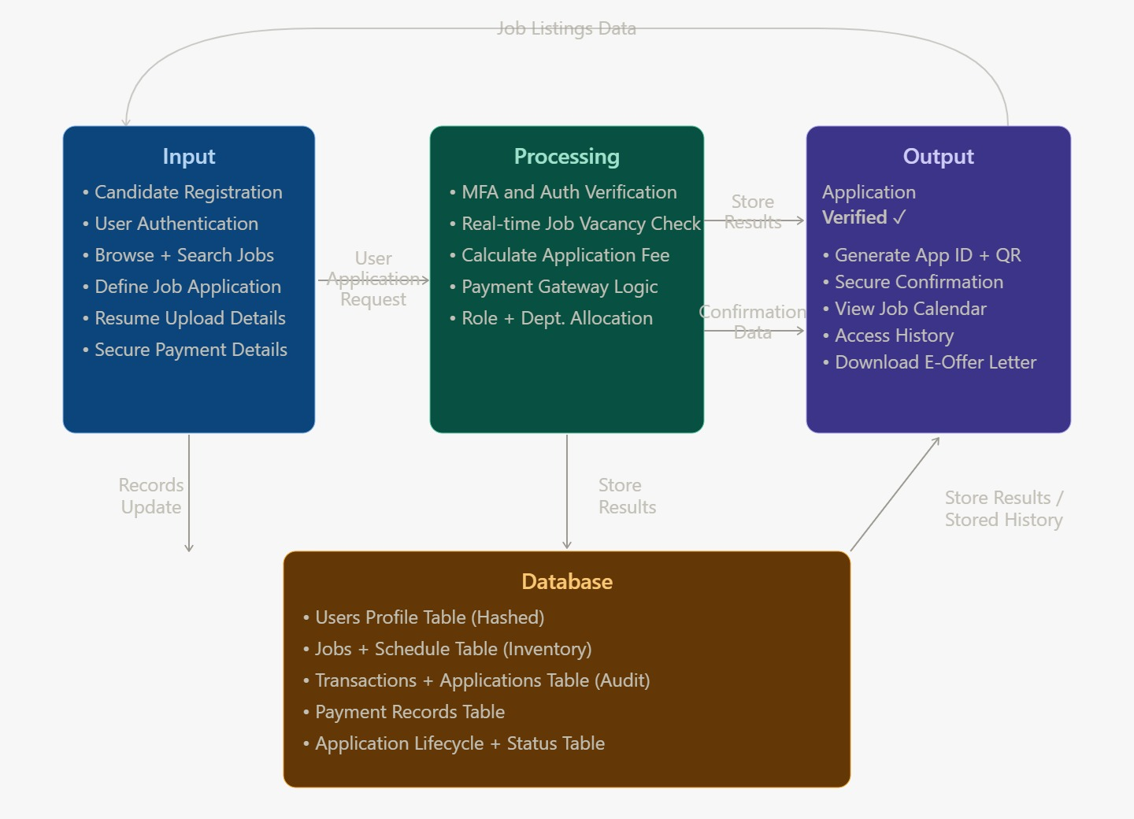
PROPOSED SYSTEM ARCHITECTURE
1
2
3
4
5
6
7
8
9

Slide 7
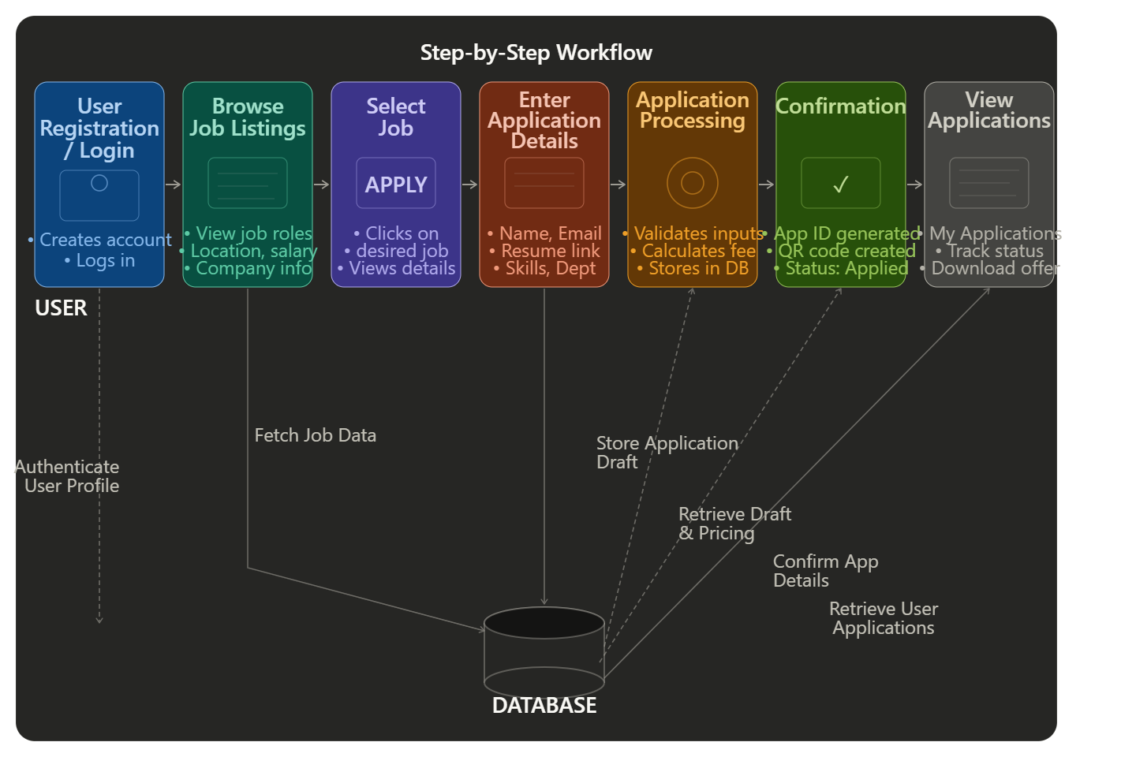
WORKFLOW
1
2
3
4
5
6
7
8
9

Slide 8
TECHNOLOGIES USED
Frontend:
React JS (Functional Components)
JSX Syntax & CSS3 Dark Theme
React Concepts:
useState Hook
Event Handling
Conditional Rendering
Component-based Architecture
State Management:
React State Management
Tools:
Node.js & npm
VS Code (Code Editor)
Chrome Browser (Testing)
Hardware / Software Requirements:
System: Windows 10
RAM: Minimum 4GB
Software: Node.js, VS Code, Browser
1
2
3
4
5
6
7
8
9

Slide 9
MODULE DESCRIPTION
Module 1: User Authentication Module
Handles user login with Full Name and Email fields.
Admin portal requires a 6-digit access code for secure entry.
1
2
Module 2: Job Listings Module
Displays job title, company name, location, salary range, and required skills. Shows available job openings count with dynamic live update after each application. Admin can create, edit, and delete job postings from the dashboard.
Module 3: Job Application Module
Input fields: Name, Email, Department, Resume Link, Number of Positions. Prevents duplicate applications; calculates total application fee in real-time. Validates all inputs before confirming the application submission.
Module 4: Validation Module
Generates digital application confirmation with unique Application ID and QR Code after submission. All fields are mandatory; email must be in valid format.
Module 5: Application Confirmation & Admin Panel Module Generates digital application confirmation with unique Application ID and QR Code after submission. Admin dashboard shows Total Applications, Jobs Posted, Revenue, Unique Candidates. Admin can Add Jobs, Edit Jobs, view Applications, and manage Settings.
3
4
5
6
7
8
9

Slide 10
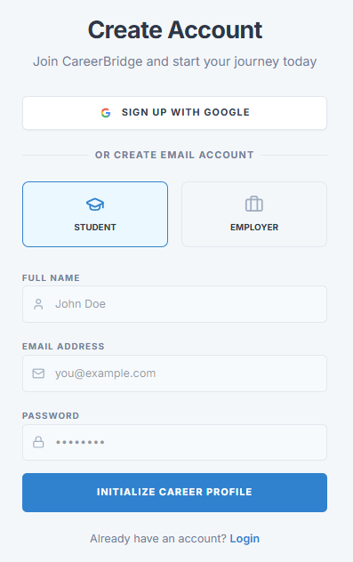
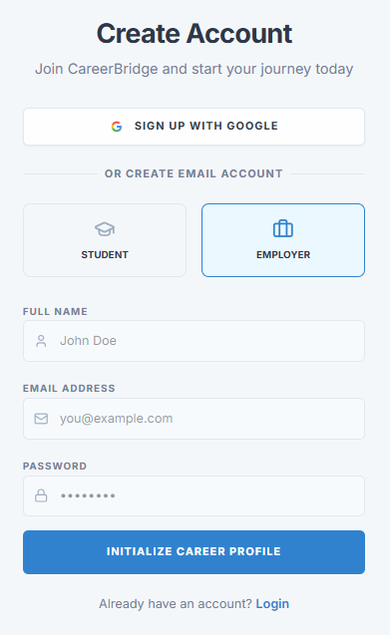
IMPLEMENTATION SCREENSHOTS
1
Login Page:
Allows users to enter Full Name and Email to access the system.
Toggle between USER and ADMIN login modes.
Continue to Booking button for seamless navigation.
Ensures secure entry to the ticket booking platform.
2
3
4
5
6
7
Admin Portal:
8
Admin can login with Name, Email, and 6-digit Access Code.
Demo Code: ADMIN2026 for secure admin access.
Redirects to Admin Dashboard after successful verification.
Ensures only authorized users can manage the platform.
9

Slide 11
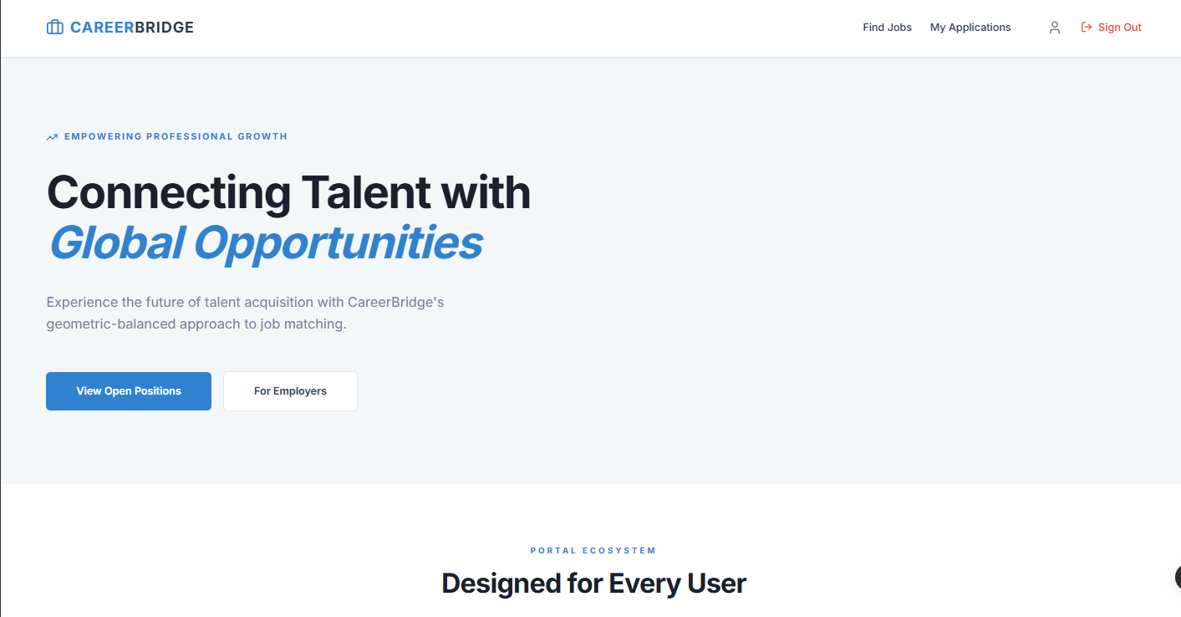
IMPLEMENTATION SCREENSHOTS
Admin Dashboard:
Shows Total Applications, Jobs Posted, Revenue & Unique Candidates.
Tabs: Dashboard, Add Job, Edit Jobs, Applications, Settings.
ecent Jobs listed with role, salary, and location details.
Admin can monitor and control all platform activities.
Job Details Page:
Displays Job Info: Role, Company, Location, Department.
Shows Application Count and Available Openings in real-time.
Job Highlights: Skills Required, Experience Level, Salary & more.
Apply Now button navigates to application module.
1
2
3
4
5
6
7
8(A)
9

Slide 12
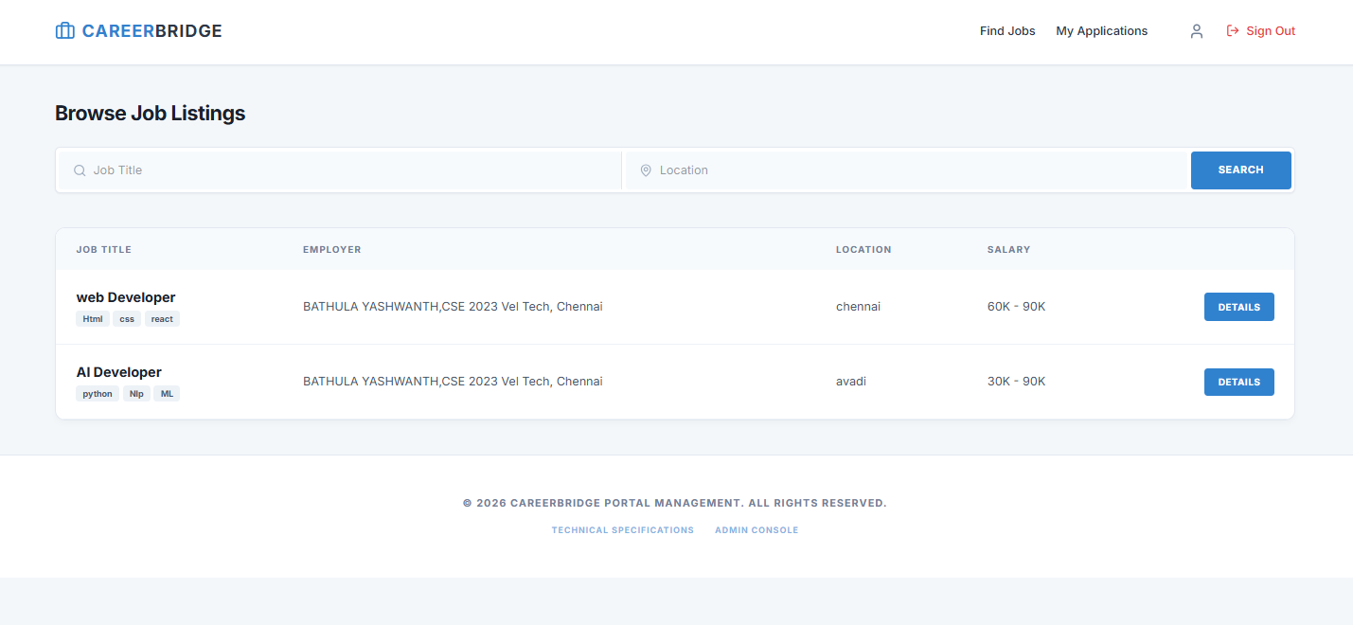
IMPLEMENTATION SCREENSHOTS
Browse Job Listings Module::
Input fields: Job Title search bar, Location filter, and Search button for quick job discovery.
Real-time job listings displayed as search filters change.
Prevents applying to unavailable jobs (vacancy check).
1
2
3
4
5
6
7
8(B)
9

Slide 13
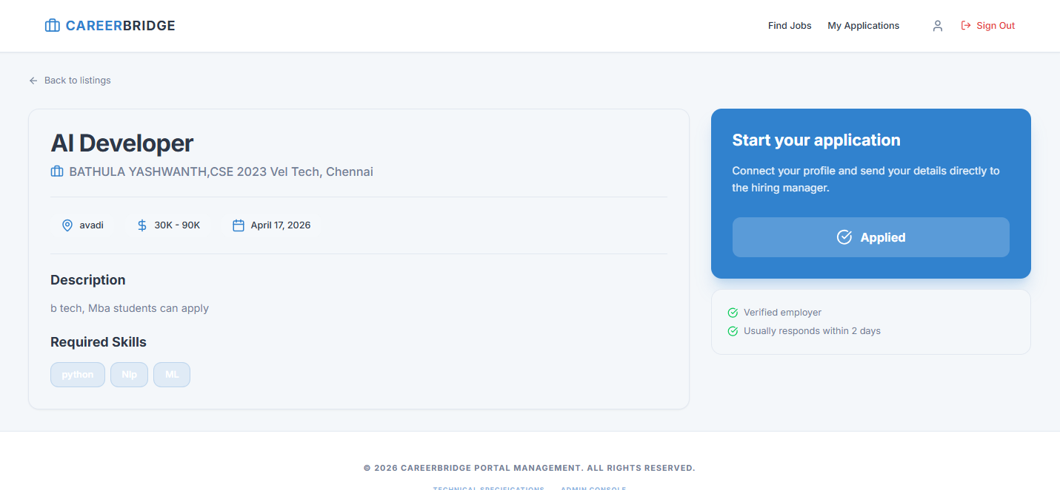
IMPLEMENTATION SCREENSHOTS
Job Details & Application Page:
After selecting a job, the system displays:
Job details with Job Title, Employer, Location, Salary Range and Posted Date.
Required Skills tags shown (e.g., Python, NLP, ML) with job description and eligibility.
Application status updated as Applied with verified employer badge and response time..
1
2
3
4
5
6
7
8(C)
9

Slide 14
ADVANTAGES & LIMITATIONS
Advantages:
Modern light-themed UI with responsive design
Real-time job vacancy update using React state
Digital application confirmation with QR code generation
Admin dashboard for complete job portal management
Form validation prevents errors and duplicate applications
Component-based React architecture for scalability
Fast SPA experience with no page reloads
Limitations:
No backend database (data in React state only)
Application data lost on page refresh (no persistence)
No real payment gateway integration
No email notification system for application confirmation
Not yet deployed as a production web application
1
2
3
4
5
6
7
8
9

Slide 15
Thank you

